Slide 1
Introduction to Hadoop (DS3203)

Slide 2
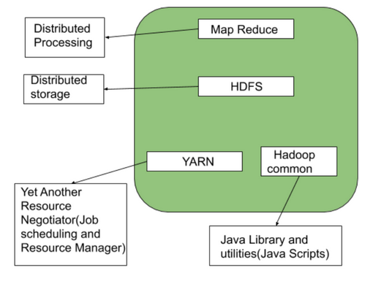
Hadoop – An Introduction
An open-source framework designed to store and process massive datasets across a cluster of hardware.
The architecture has 4 components :
HDFS(Hadoop Distributed File System)
MapReduce
YARN(Yet Another Resource Negotiator)
Common Utilities or Hadoop Common

Slide 3
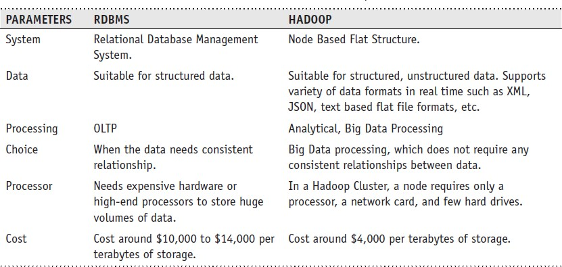
RDBMS versus HADOOP

Slide 4
Distributed Computing Challenges
Hardware Failure
How to Process This Gigantic Store of Data?

Slide 5
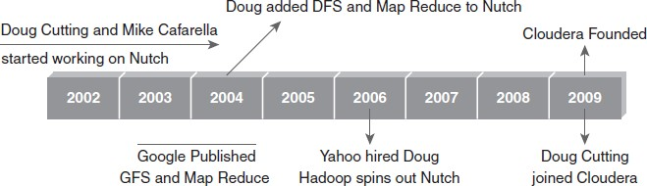
History of Hadoop

Slide 6





Hadoop’s Developers
2005: Doug Cutting and Michael J. Cafarella developed Hadoop to support distribution for the Nutch search engine project.
The project was funded by Yahoo.
2006: Yahoo gave the project to Apache
Software Foundation.
Doug Cutting

Slide 7
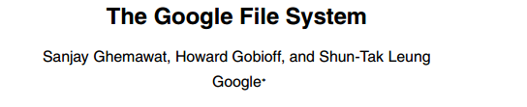

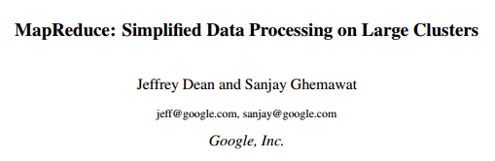


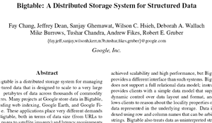
Google Origins
2003
2004
2006

Slide 8
Some Hadoop Milestones
2008 - Hadoop Wins Terabyte Sort Benchmark (sorted 1 terabyte of data in 209 seconds, compared to previous record of 297 seconds)
2009 - Avro and Chukwa became new members of Hadoop Framework family
2010 - Hadoop's Hbase, Hive and Pig subprojects completed, adding more computational power to Hadoop framework
2011 - ZooKeeper Completed
2013 - Hadoop 1.1.2 and Hadoop 2.0.3 alpha.
- Ambari, Cassandra, Mahout have been added

Slide 9
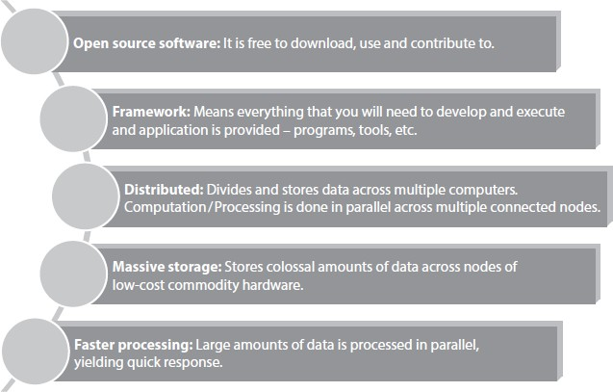
Hadoop Overview
Key Aspects of Hadoop

Slide 10
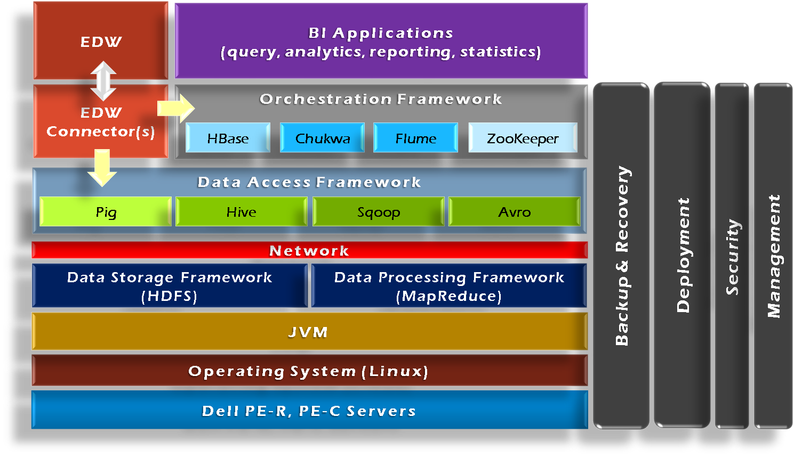
Hadoop Framework Tools

Slide 11
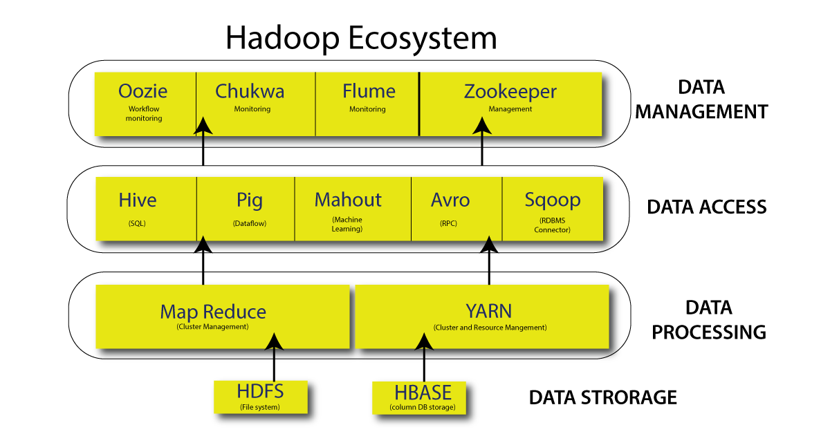

Slide 12
Hadoop Components
HDFS:
(a) Storage component.
(b) Distributes data across several nodes.
(c) Natively redundant.
MapReduce:
(a) Computational framework.
(b) Performs distributed processing in parallel in a Hadoop cluster.

Slide 13
Hadoop Components
Pig:
(a) High-level scripting platform for processing and analyzing large datasets.
(b) Uses scripting language called Pig Latin.
(c) Used in log processing and data transformation in Hadoop-based systems.
Hive:
(a) SQL like query tool built on top of Hadoop.
(b) Used to run structured queries on large datasets using HiveQL language.
(c) Used in data warehousing and business intelligence.

Slide 14
Hadoop Components
Mahout:
(a) Machine learning and data mining library.
(b) Provides ML algorithms for classification, clustering and recommendation systems.
(c) Works efficiently with HBase, HDFS and Hive.
Oozie:
(a) Workflow scheduler for managing and automating Hadoop jobs.
(b) Used in big data analytics workflows, ETL automation, and batch job scheduling in Hadoop environments.

Slide 15
Hadoop Components
HBase:
(a) NoSQL, distributed, column-oriented database that runs on Hadoop.
(b) Provides real-time read/write access to large datasets stored in HDFS.
(c) Works with MapReduce, Hive, and Pig for analytics.
Flume:
(a) Distributed data ingestion tool.
(b) Used for collecting, aggregating, and transporting large volumes of streaming data into HDFS, HBase, or other Hadoop storage systems in real-time.

Slide 16

Hadoop Distributors

Slide 17
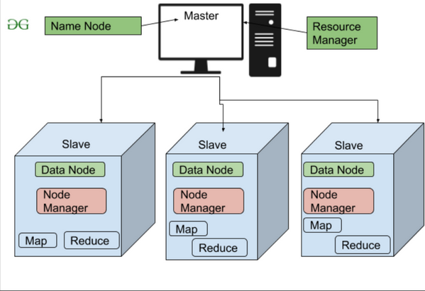
HDFS High Level Architecture

Slide 18
HDFS (Hadoop Distributed File System)

Slide 19
HDFS (HADOOP DISTRIBUTED FILE SYSTEM)
Storage component of Hadoop.
Distributed File System modeled after Google File System.
Distributed Storage System - Stores large datasets by splitting files into blocks and distributing them across multiple nodes in a Hadoop cluster.
Fault Tolerance - Data blocks are replicated (default: 3 copies) across different nodes to ensure data availability even if a node fails.
Scalability - HDFS supports horizontal scaling, meaning new nodes can be added seamlessly to handle growing data volumes.
Write-Once, Read-Many – Files in HDFS are immutable, optimized for high-throughput read operations rather than frequent modifications.
Master-Slave Architecture – HDFS consists of a NameNode (master) that manages metadata and DataNodes (slaves) that store actual data blocks.

Slide 20
HDFS Daemons
NameNode:
Single NameNode per cluster.
Keeps the metadata details
DataNode:
Multiple DataNode per cluster
Stores file blocks
Read/Write operations
SecondaryNameNode:
Housekeeping Daemon

Slide 21
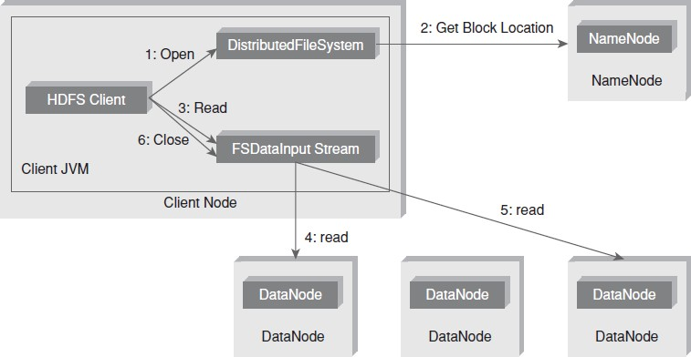
Anatomy of File Read

Slide 22
Anatomy of File Read
Client Requests to Open the File - The HDFS client contacts the NameNode to request access to a file.
NameNode Provides Block Locations - The NameNode does not store actual data but tells the client where (which DataNodes) the file blocks are stored.
Client Reads from DataNodes - The HDFS client contacts the first DataNode holding the required block and starts reading data.
Reading Blocks from Multiple DataNodes - If the file is large, it is split into multiple blocks across different DataNodes, and the client reads them sequentially.
Client Reads Remaining Blocks - The client continues reading blocks from the assigned DataNodes until the entire file is retrieved.
Client Closes the Connection – After reading, the client closes the connection, and the process is complete.

Slide 23
Role of FSDataInputStream
FSDataInputStream is useful when reading large files in HDFS specially when seeking specific parts of the file without loading the entire content into memory.
Supports seek operations (random access to different positions in the file).
Optimized for handling large files in a distributed environment.

Slide 24
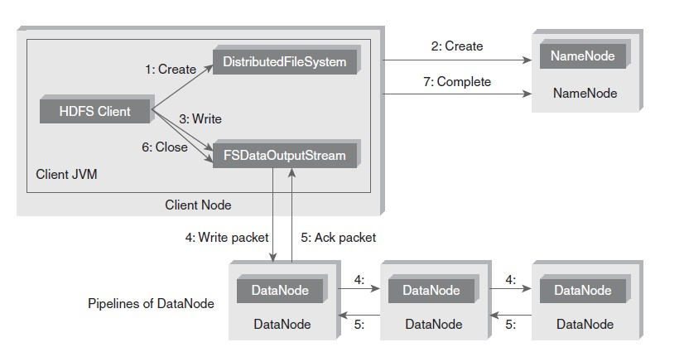
Anatomy of File Write

Slide 25
Anatomy of File Write
Client Requests to Create a File - The HDFS client asks the NameNode to create a new file in HDFS.
NameNode Confirms Creation - The NameNode checks whether the file already exists and whether the client has the necessary permissions. If everything is valid, it reserves space for the file and responds to the client.
Client Starts Writing Data - The client writes data to FSDataOutputStream, which is responsible for sending data packets to DataNodes.
Data is Sent to DataNodes in a Pipeline - The data is broken into blocks and sent to the first DataNode. The first DataNode then forwards the data to the second DataNode, which further forwards it to the third DataNode (ensuring replication).
Acknowledgement (ACK) is Sent Back - Each DataNode sends an acknowledgment (ACK) back to the client after successfully writing a block.
Client Closes the File - Once all the blocks are written and acknowledged, the client closes the file.
NameNode Updates Metadata - The NameNode updates the file metadata, marking the write process as complete.
Notes:
The NameNode only manages metadata; it does not store actual data.
DataNodes store file blocks and replicate them for fault tolerance.
The pipeline mechanism ensures data is written efficiently across multiple nodes.

Slide 26
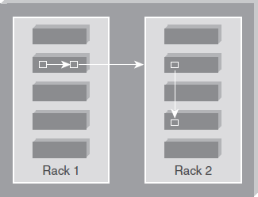
Replica Placement Strategy
As per the Hadoop Replica Placement Strategy, first replica is placed on the same node as the client.
Then it places second replica on a node that is present on different rack.
It places the third replica on the same rack as second, but on a different node in the rack.
Once replica locations have been set, a pipeline is built. This strategy provides good reliability.

Slide 27
Working with HDFS Commands
Objective: To create a directory (say, sample) in HDFS.
Act:
hadoop fs -mkdir /sample
Objective: To copy a file from local file system to HDFS.
Act:
hadoop fs -put /root/sample/test.txt /sample/test.txt
Objective: To copy a file from HDFS to local file system.
Act:
hadoop fs -get /sample/test.txt /root/sample/testsample.txt

Slide 28
Special Features of HDFS
Data Replication:
There is absolutely no need for a client application to track all blocks.
It directs the client to the nearest replica to ensure high performance.
Data Pipeline:
A client application writes a block to the first DataNode in the pipeline.
Then this DataNode takes over and forwards the data to the next node in the pipeline.
This process continues for all the data blocks, and subsequently all the replicas are written to the disk.

